Slide 1
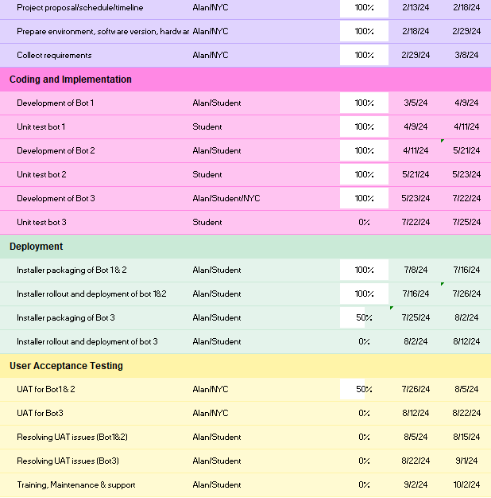
Project Timeline (update in Jul 24)
Bot1
Completed and deployed in production. Record manager has also done the UAT in her laptop and is functioning according to requirement.
Doing a demo on 31 Jul
Bot2
Completed and deployed in production. Record manager has also done the UAT in her laptop and is functioning according to requirement.
Doing a demo on 31 Jul
Bot3
NYP + NYC have completed the Bot 3
Bulk cut and paste approach to meet Initial requirement
Individual file transfer approach to handle files not filed at the level 4 folders
Doing a demo on 31 Jul
Once user is ok with Bot3, we will kickstart the UAT for Bot 3.

Slide 2
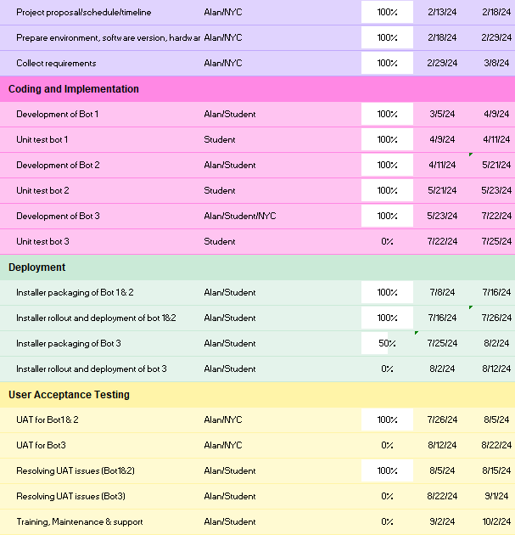
Project Timeline (update in Aug 24)
Bot1
Completed the UAT. Resolved the UAT issues and signed off requirements.
Bot2
Completed the UAT. Resolved the UAT issues and signed off requirements.
Bot3
NYP + NYC have completed the Bot 3
Bulk cut and paste approach to meet Initial requirement
Individual file transfer approach to handle files not filed at the level 4 folders
Presented the Bot 3 to security team on 31 Jul. Pending security team to provide clearance to deploy in production to do UAT.
Propose to do a prelim UAT in end-user PC with UAT environment first to delink the deployment and UAT. ➔ However, UAT must still be done in the production thereafter)
Proposing a new timeline in next slide

Slide 3
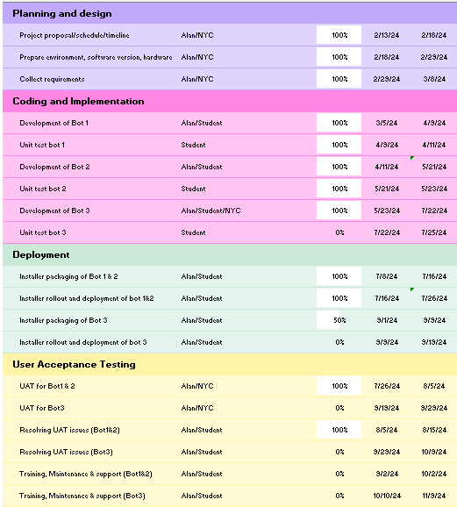
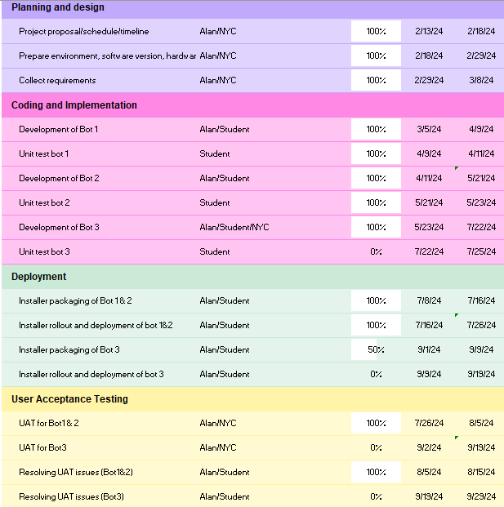
New Project Timeline (update in Aug 24)
Bot1
Completed the UAT. Resolved the UAT issues and signed off requirements.
Bot2
Completed the UAT. Resolved the UAT issues and signed off requirements.
Bot3
Although we can shorten the UAT time slightly by doing a prelim testing of Bot3 in production PC + UAT environment, UAT still need to be done in production.
Hence, this new timeline is still subjected to the deployment date [target to start deployment in production in early Sept]

Slide 4
Next Steps
To kickstart Bot3 UAT

Slide 5
Bot1 list out all the files that can/cannot be uploaded to e-Reg
With details of filesize, filedirectory, last edit, file format in excel
Bot1 sends the link of the stored summary report in DCS Workspace to RM for review
Bot2 will move the files and update the summary report indicating that the files are moved
Deletes the processed files stored in DCS Workspace.
Bot3 access E-reg Web Application via UI automation to file explorer
Bot3 moves each files from local host to E-registry
RPA Bot
Bot2 will move the files and update the summary report whether the files are moved
Bot1 check through every doc uploaded by record owner
1. File size up to 100MB
2. File format is not video formats (.mp4, .mov, .wmv, .avi, .flv, swf, mkv, mpeg-2)
End
Bot3 extract all the content in each folder with UI automation (e.g mimic human to cut and paste, and type file path into file explorer of e-Reg system
Bot3 identify files not moved in this run and create a list
Bot2 will move the files and update the summary report whether the files are moved
processed files will be removed from the temporary storage in local machine
Bot1 identify each file in these folders and map out their directory
Bot2 will identify all the files in DCS workspace to be moved to the local machine
<To prepare for the UI automation>
Bot3 starts UI automation and computer vision to mimic human to access all files in each folder local machine
Bot1 Reads the doc “folderInNYC Transformation Team”
Record
mgr
RM inform RO to remove files that cannot be uploaded to e-Reg
RM review report and trigger Bot2
RM to trigger Bot3 after Bot2 completed
RM trigger Bot1
End
Record
owner
Team drops file into DCS Workspace (For Filing) folder
start

Slide 6
Bot1 is for identifying the duplicate folder to store all the files (e.g .docx and xlsx). è so if there are no duplicate folder(s), we can then drill into the bots and nuts and what file extensions. This is also to reduce run time and quickly eliminate bulk of the duplication in advance.
Bot2 is to specify what are the details in each folder to be filed into a e-registry. So it will output a list of files directories, excluding all the videos, exe, and other extension of file >100mb.
Bot3 will either do the Ui Automation or direct file transfer (if possible) to upload files into the e-registry web portal.
So from our output provided by bot2 showing a list of all the file directory of every single file, it will check its existence (fileExist), then access the file and transfer to the e-registry.

